Slide 1

Module 0
Introduction to R
Notes:
Guidelines
Use section headers to chunk content in your presentation.
Use the same style of section header throughout your presentation.
Keep your title to no more than 2 lines.

Slide 2

Reading Data into R
Notes:
Guidelines
Use a title slide at the beginning of your presentation. There are 9 variations of title slides to choose from.
If you will have a series of slideshows, we recommend using the same style of title slide for each presentation.
Keep your title to no more than 2 lines.
Do not change the font style or font size of the title or subtitle.

Slide 3
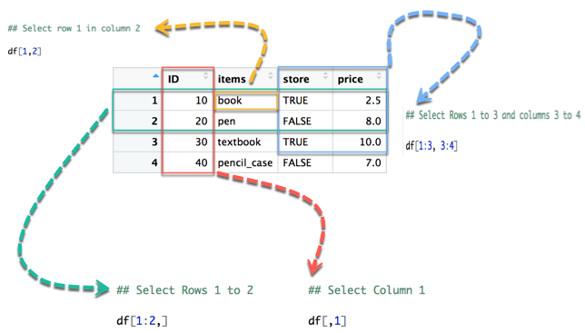
Data Structures – Data Frames
Similar to matrices but can contain different data types

Slide 4
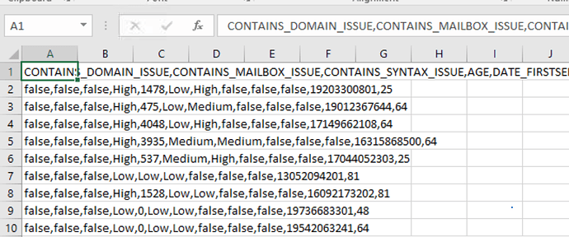
Reading Data
The main functions to read text data (.csv, .txt) are:
read.csv()
read.table()
COMMA SEPARATED

Slide 5
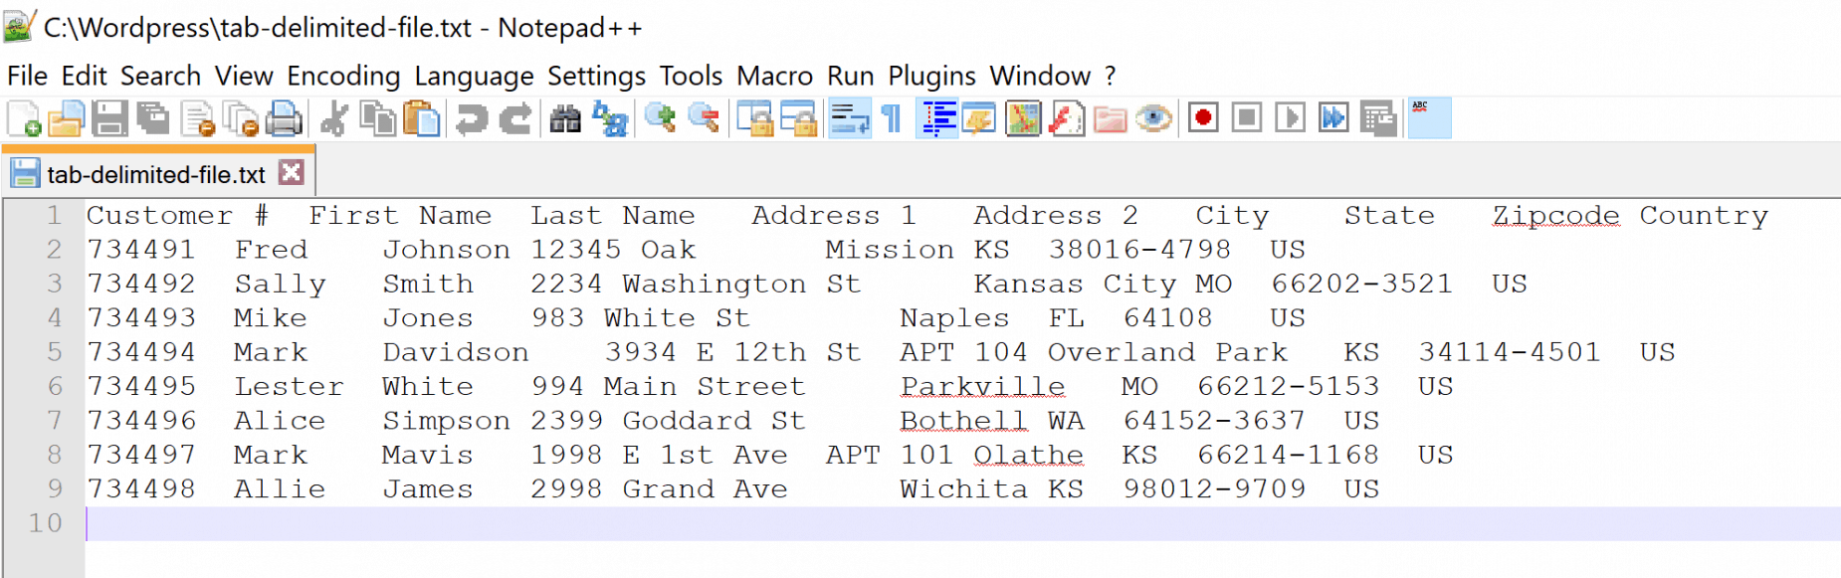
Reading Data
The main functions to read text data (.csv, .txt) are:
read.csv()
read.table()
TAB SEPARATED

Slide 6
Parameters of read.csv and read.table
The main parameter settings are:
header = T makes sure the first line is read as variable names
sep = “,” option on what separates each data value
stringsAsFactors = T to read strings as factor variables
COMMA SEPARATED

Slide 7
Headers
A header indicates whether the first row contains the variable names:
header = T

Slide 8
Reading Data
The main functions to read text data (.csv, .txt) are:
read.csv()
read.table()
Example using read.csv()function :
df = read.csv(“file.csv”, stringsAsFactors = T)
Name of Object
assigned
File name with PATH
e.g.
“/users/files/file.csv”
“github.com/user/file.csv”
Converts all character variables to type factor

Slide 9
Reading Data
The main functions to read text data (.csv, .txt) are:
read.csv()
read.table()
Example using read.table()function :
df = read.table(“file.txt”, sep = “\t”, header = T, stringsAsFactors = T)
Name of Object
assigned
File name with PATH
e.g.
“/users/files/file.txt”
“github.com/user/file.txt”
Changes separator to TAB
Reads first line as variable names

Slide 10
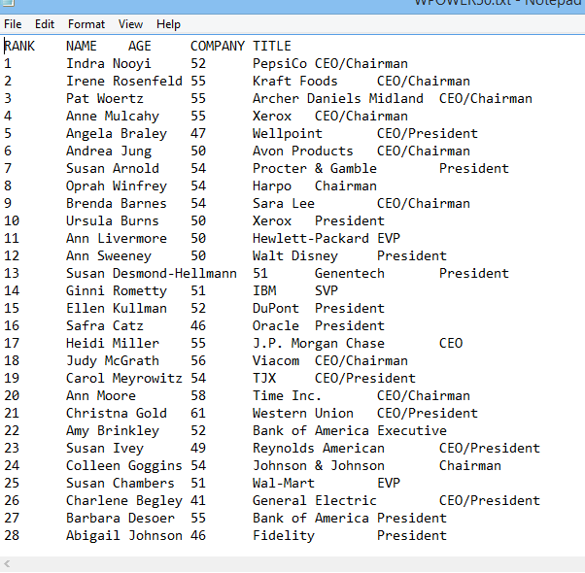
Let’s Read the POWER50.txt dataset
How is it delimited (separated)?
Do we use header = T or F

Slide 11

Practice

Slide 12
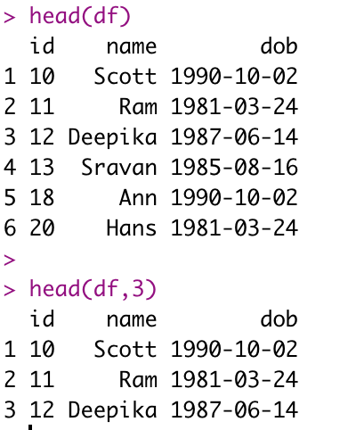
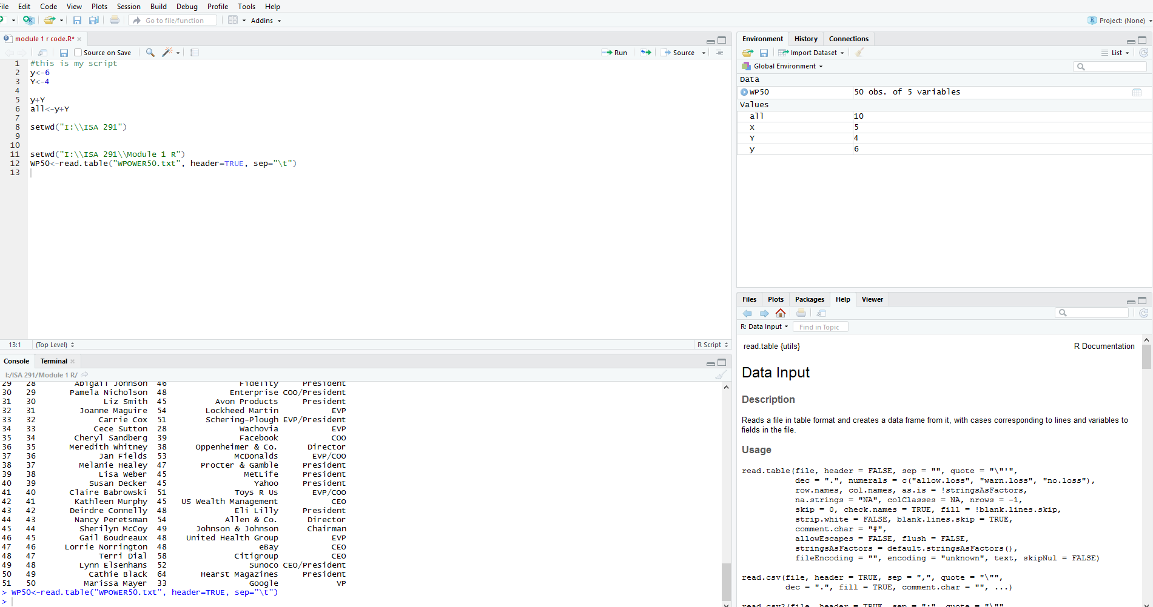
Inspecting the data set
Making sure the data was read correctly

Slide 13
Practice

Slide 14
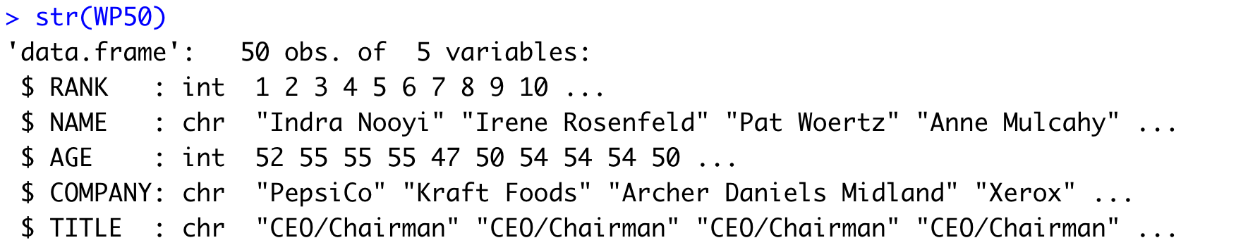
Checking Variable Types
Remember variable types can be
Numeric—continuous number
Integer—1, 2, 3, 5…..etc.
Logical—0/1 or FALSE/TRUE or F/T
Character – Strings (we want to code them as factor instead)

Slide 15
Practice

Slide 16

Other Ways to Read Data
Pre-loaded data sets
Data from packages

Slide 17
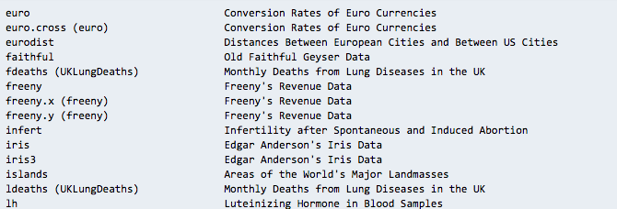
Pre-loaded data sets
You can use the data() function to list pre-loaded datasets
Just use the data as named in the list

Slide 18
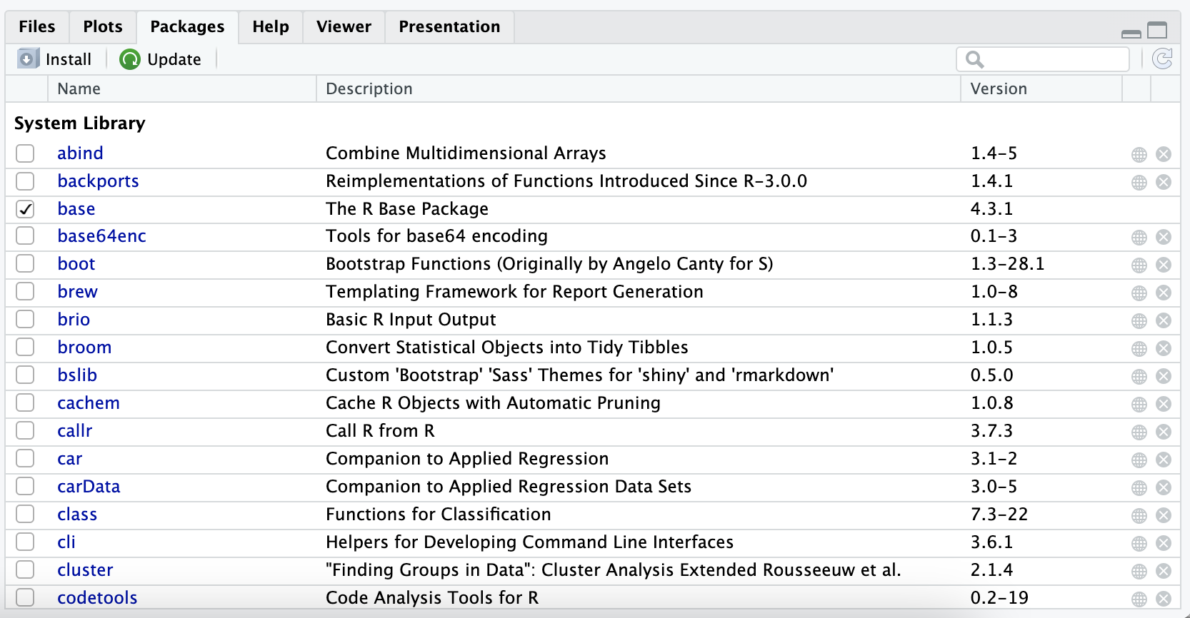
Packages
You can install packages using install.packages()
Make sure to ”load” the package using library()
You can also use the “file, plots, packages,…” panel

Slide 19
Data sets from packages
You can use the data() function after loading packages
Data sets from packages show

Slide 20
Practice

Slide 21
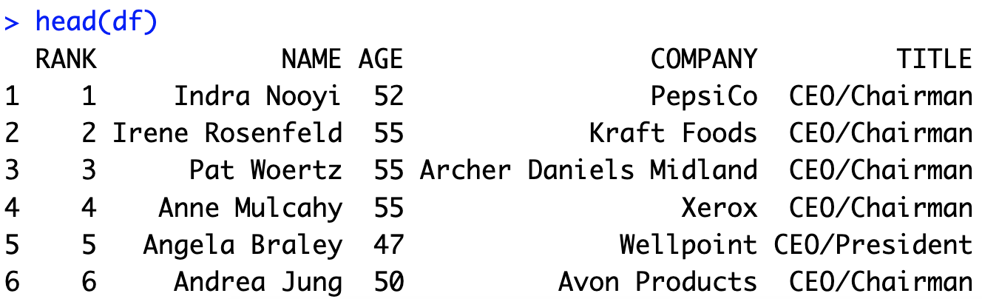
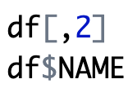
Selecting 1 Variable
You can select variables using indexing
You can also use object $ notation

Slide 22
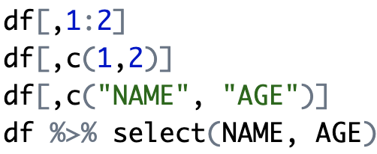
Selecting More than 1 Variable
You can select variables using indexing
You can also use object $ notation
Requires package dplyr

Slide 23
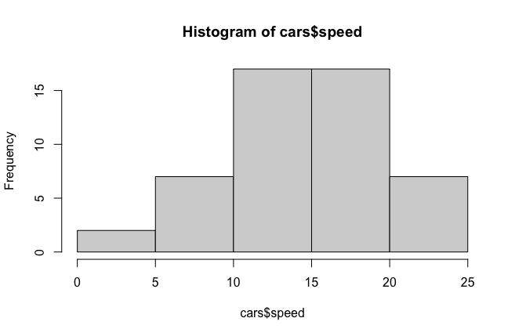
Histograms
Provides a visual representation of the distribution of the data
You can use the function: hist()

Slide 24
Practice

Slide 25
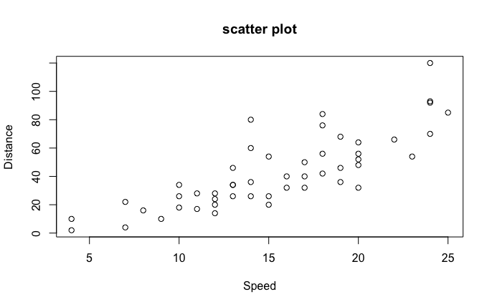
Scatterplot
Provides bivariate relationships
You can use the function: plot()

Slide 26
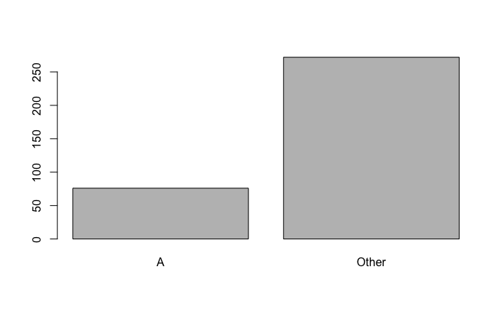
Bar Chart
Provides frequencies of categorical variables
You can use the function: barplot(table())

Slide 27
Subsetting Rows
Used to conditionally select data
You can the bracket notation: [rows, cols]
Conditions for rows
You can use the subset function
Conditions

Slide 28
Practice

